Slide 1
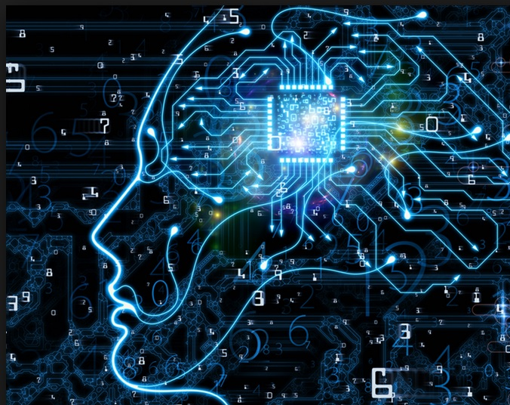
Introduction to Machine Learning
Thomas J Varghese
Machine Learning Engineer
This Photo by Unknown author is licensed under CC BY-SA-NC.

Slide 2

Contents...
History
What is Machine Learning?
Types of Machine Learning
Key Terminologies
Data Preprocessing
Feature Selection and Feature Engineering.
Model Training and Evaluation.
Evaluation Metrics

Slide 3
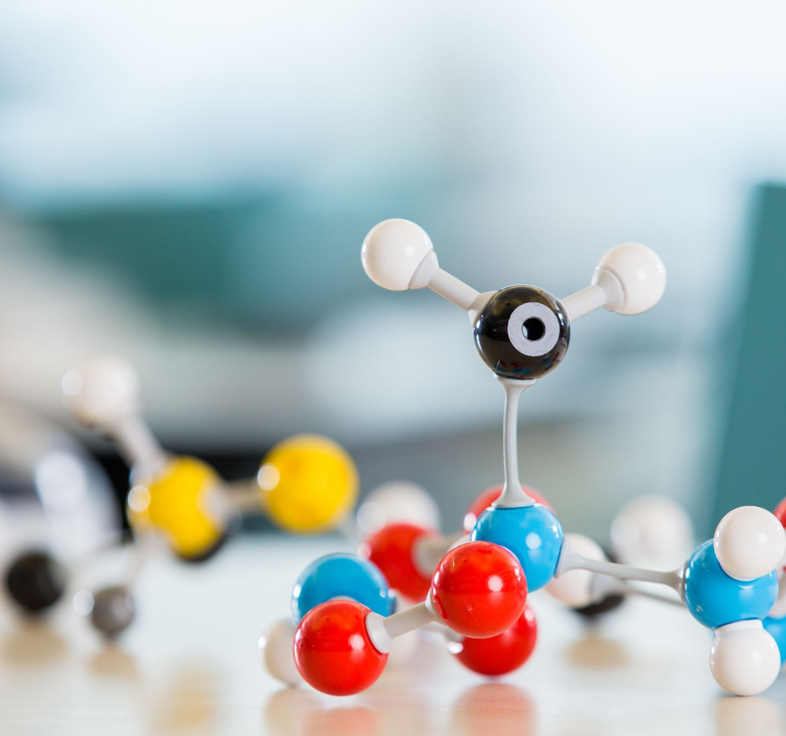
...Contents
Cross-Validation
Overfitting and Underfitting: Bias-Variance Tradeoff.
Model Selection and Evaluation
Transfer Learning and Pre-trained Models.
Applications of Machine Learning

Slide 4
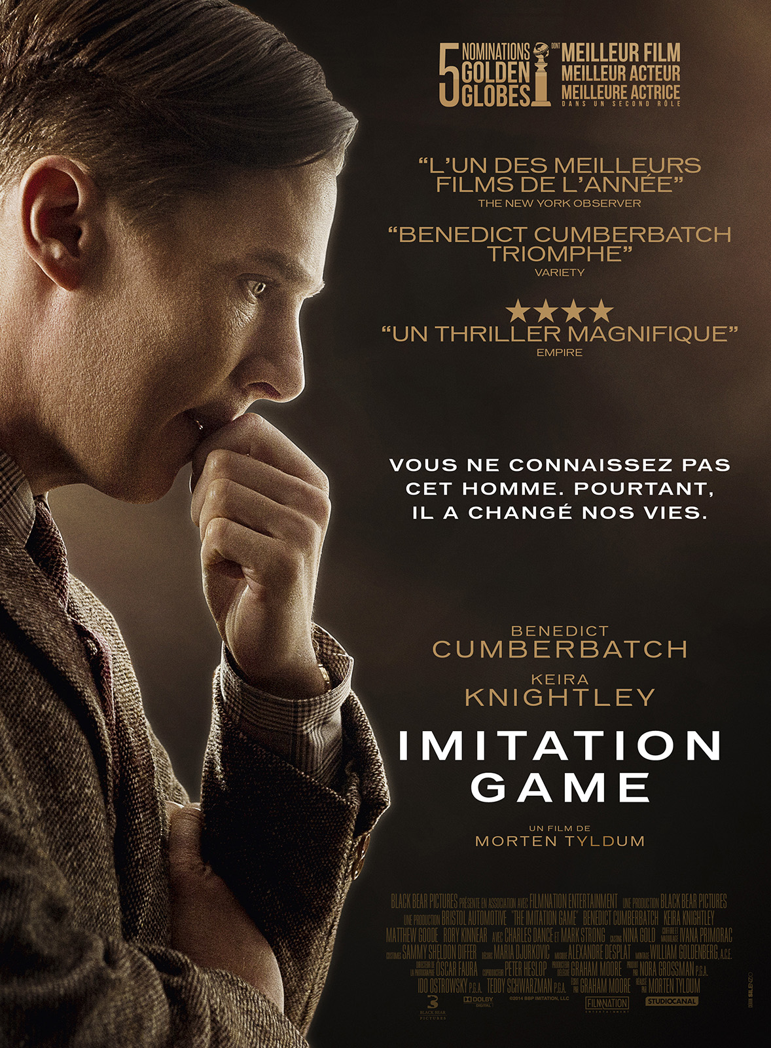
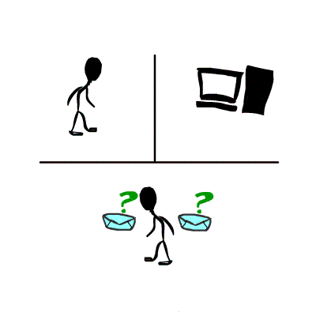
History: Let's start with Turing Test

Slide 5
1950
“Turing test- imitation game”
1957
“perceptron”- Frank Rosenblot
1967
“nearest neighbour” algorithm – pattern identification
1979
The Backpropagation algorithm is developed, allowing for efficient training of multi-layer neural networks
1981
Gerald DeJong's Explanation-Based Learning (EBL) introduces the idea of generalizing knowledge from specific instances.
1986
The Boltzmann Machine is proposed, laying the groundwork for the development of deep learning models.
1995
Reinforcement Learning gets a boost with the introduction of the Q-Learning algorithm by Watkins and Dayan.
1997
IBM's Deep Blue defeats chess world champion Garry Kasparov, showcasing the power of machine learning in game playing.
IBM's Watson wins Jeopardy, demonstrating the capabilities of natural language processing and machine learning.
2006
Geoffrey Hinton's work on Deep Belief Networks brings renewed interest in deep learning and unsupervised learning.
2011

Slide 6
2012
AlexNet, a deep convolutional neural network, achieves a significant breakthrough in image recognition, winning the ImageNet competition.
2014
Generative Adversarial Networks (GANs) are introduced by Ian Goodfellow, enabling the generation of realistic synthetic data.
2015
DeepMind's AlphaGo defeats world champion Lee Sedol in the complex game of Go, showcasing advancements in reinforcement learning.
2017
OpenAI's Dota 2 bot defeats professional players, demonstrating the potential of machine learning in complex strategy games.
2018
Transformer models, such as BERT (Bidirectional Encoder Representations from Transformers), revolutionize natural language processing tasks.
2019
DeepMind's AlphaStar reaches Grandmaster level in the game of StarCraft II, highlighting the adaptability of AI in real-time strategy games.
2020
GPT-3 (Generative Pre-trained Transformer 3) is introduced, demonstrating impressive natural language generation capabilities.
2021
DeepMind's AlphaFold makes a significant breakthrough in protein folding prediction, contributing to advancements in bioinformatics and drug discovery.
2022
ChatGPT and Midjourney was introduced

Slide 7

What is machine learning? (layman)
Teaching a computer how to learn and make decisions by showing it lots of examples.
Not explicitly tells the computer what to do;
Give it a large amount of data →figure out patterns and make predictions on its own.

Slide 8

“Field of study that gives computers the ability to learn without being explicitly programmed.”
-Arthur Samuel (1959)
Eg: Cats and dogs classification

Slide 9
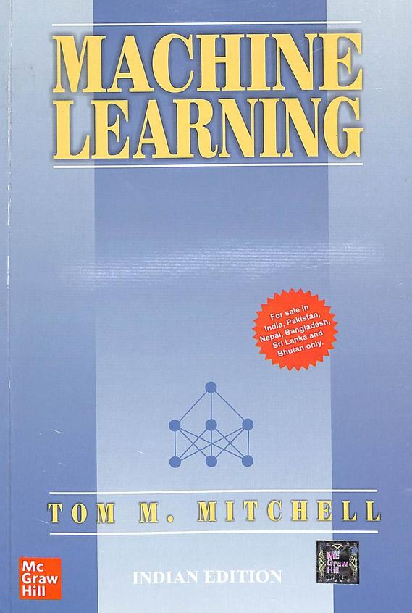
What is machine learning? (academic)
Definition by Tom Mitchell (1998):
Study of algorithms that
• improve their performance P
• at some task T
• with experience E.
A well-defined learning task is given by .

Slide 10
Some examples
T: Playing chess
P: Percentage of games won against an arbitrary opponent
E: Playing practice games against itself
T: Recognizing hand-written words
P: Percentage of words correctly classified
E: Database of human-labeled images of handwritten words
T: Driving on four-lane highways using vision sensors
P: Average distance traveled before a human-judged error
E: A sequence of images and steering commands recorded while observing a human driver.

Slide 11
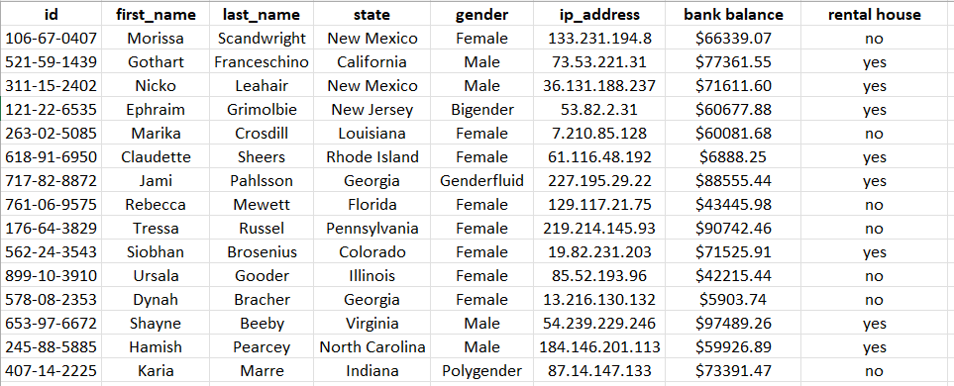
Key terminologies
FEATURES
LABEL
Data
Features
Labels
Training
Testing and
Model
DATA

Slide 12
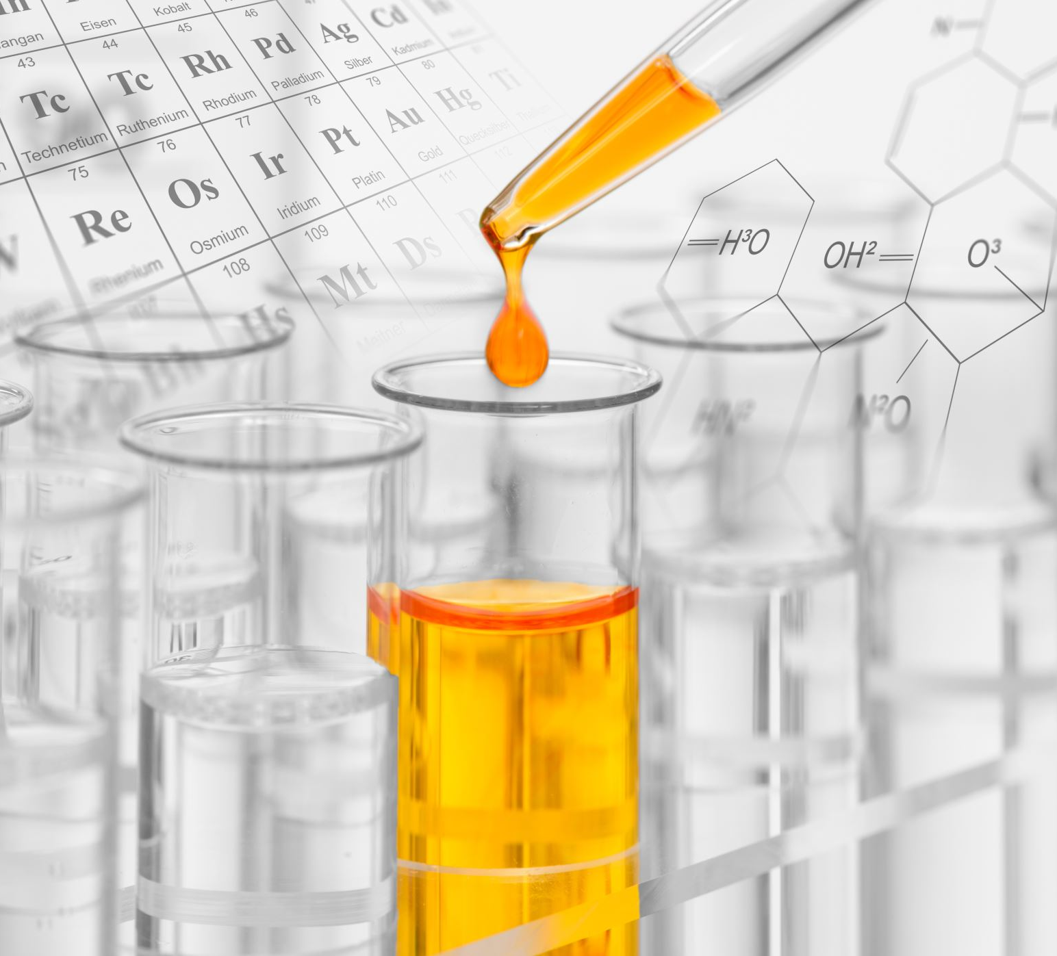
Types of ML
Supervised
Unsupervised
Semi-supervised and
Reinforcement

Slide 13
Supervised ML
Given: training data + desired outputs (labels)
Labelled data
Train-test-val split
Training phase
Modelling
Testing and validation
Prediction

Slide 14
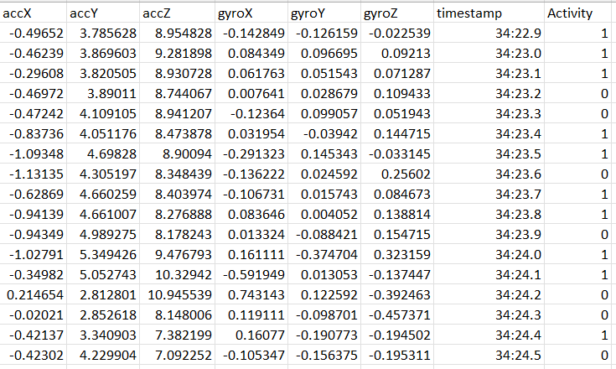
Example: Accelerometer dataset

Slide 15
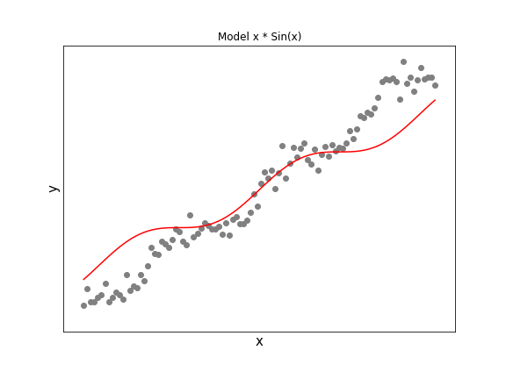
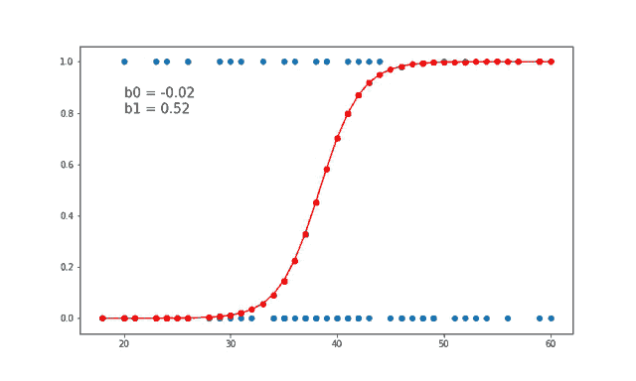
Supervised ML algorithms
Regression
Classification
Logistic regression for binary classification
Decision Tree
SVM
Neural networks etc

Slide 16
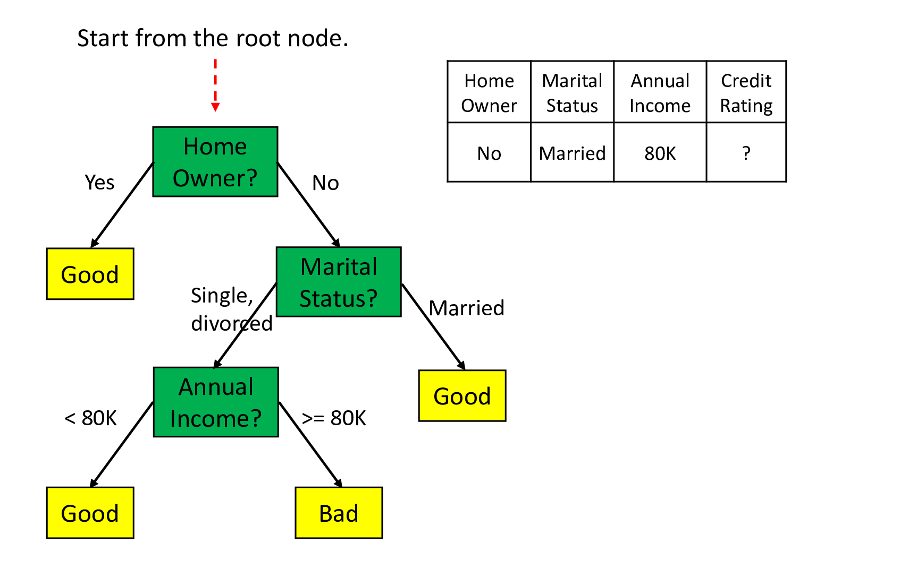
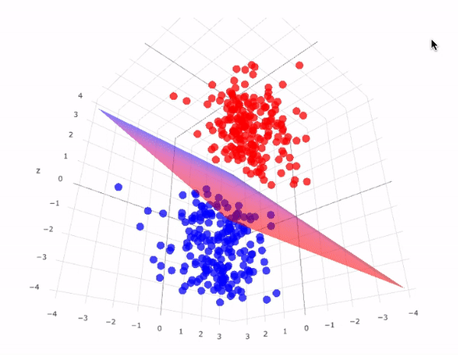
Decision tree
Support Vector Machine

Slide 17
Unsupervised ML
Algorithm learns patterns from unlabeled data.
i.e, no predefined labels or desired outputs provided.
Algorithm identifies inherent patterns, structures, or relationships in the data on its own.

Slide 18

Example:
K-means Clustering
Divides dataset to k different clusters.
Each cluster should have similar properties.

Slide 19
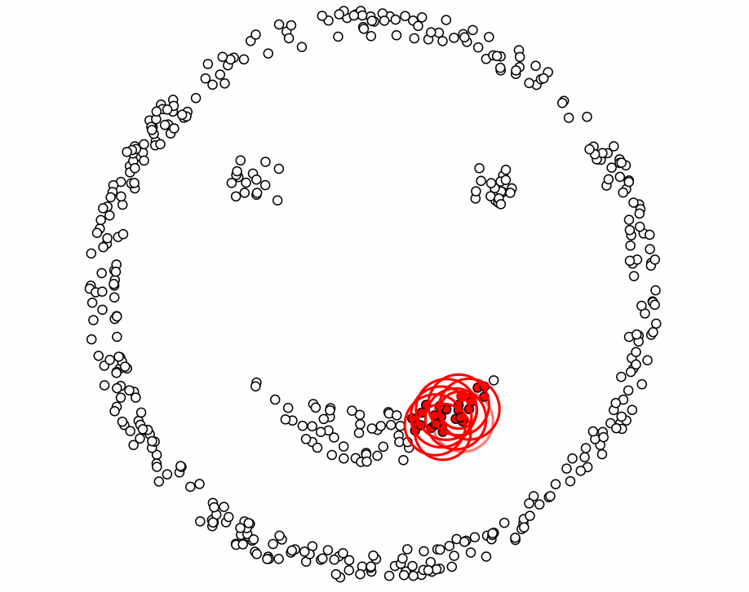
Other Unsupervised ML algorithms
PCA
t-SNE
Apriori algorithm
DBSCAN etc..

Slide 20
Semi-supervised ML
In scenarios where manually labeling a large amount of text data is time-consuming or expensive, semi-supervised learning can be useful.
Algorithms:
Self training
Co-training
Transductive SVM
Multiview learning

Slide 21
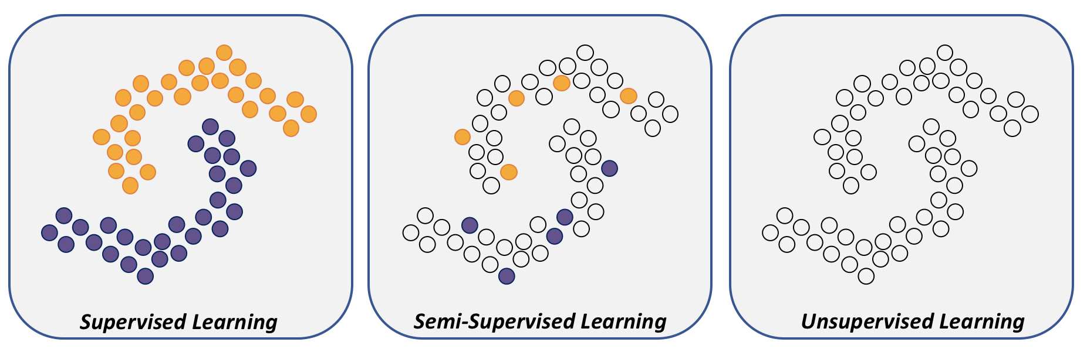
Semi-supervised ML
Applications:
Text Classification with Limited Labeled Data
Image Classification with Partial Labels
Fraud Detection in Financial Transactions
Image Segmentation
Speech Recognition with Limited Transcriptions etc

Slide 22

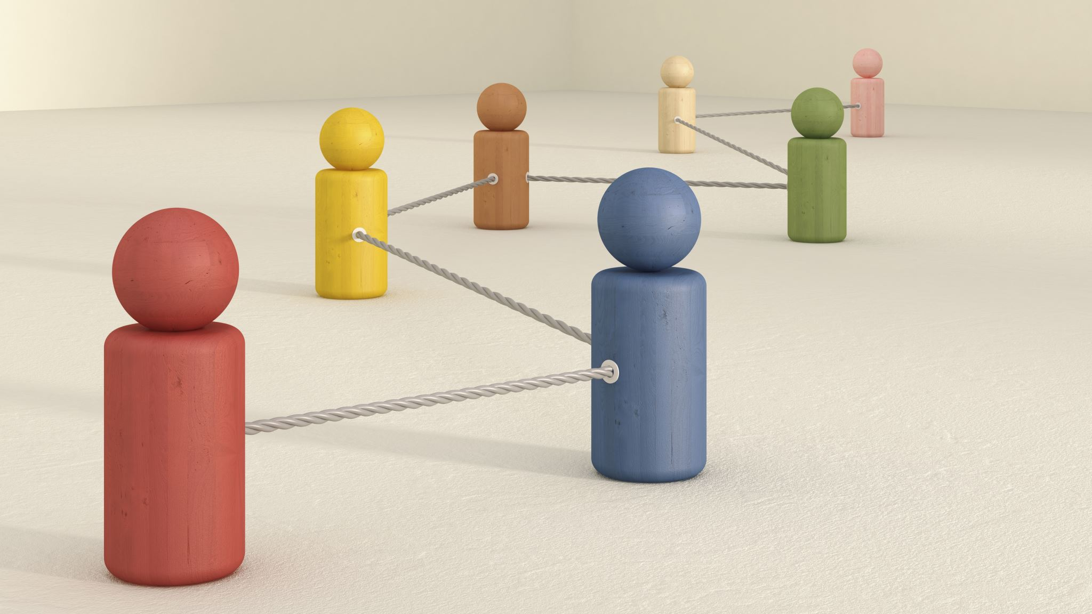


Reinforcement learning
Learning through interaction
No labels
The agent learns to make decisions by interacting with an environment.
The agent takes feedback (rewards or punishments) and improves.

Slide 23

Reinforcement learning
Algorithms
Q-Learning
Deep Q Networks (DQN)
Policy gradient methods
Actor critic methods
Monte Carlo Tree Search etc
This Photo by Unknown author is licensed under CC BY-SA.

Slide 24
ML Life Cycle
Data collection
Pre-processing
Feature Engg
Modeling
Deployment
Splitting
Feature Selection

Slide 25
Data Preprocessing
Cleaning
Transformation and
Feature Scaling

Slide 26
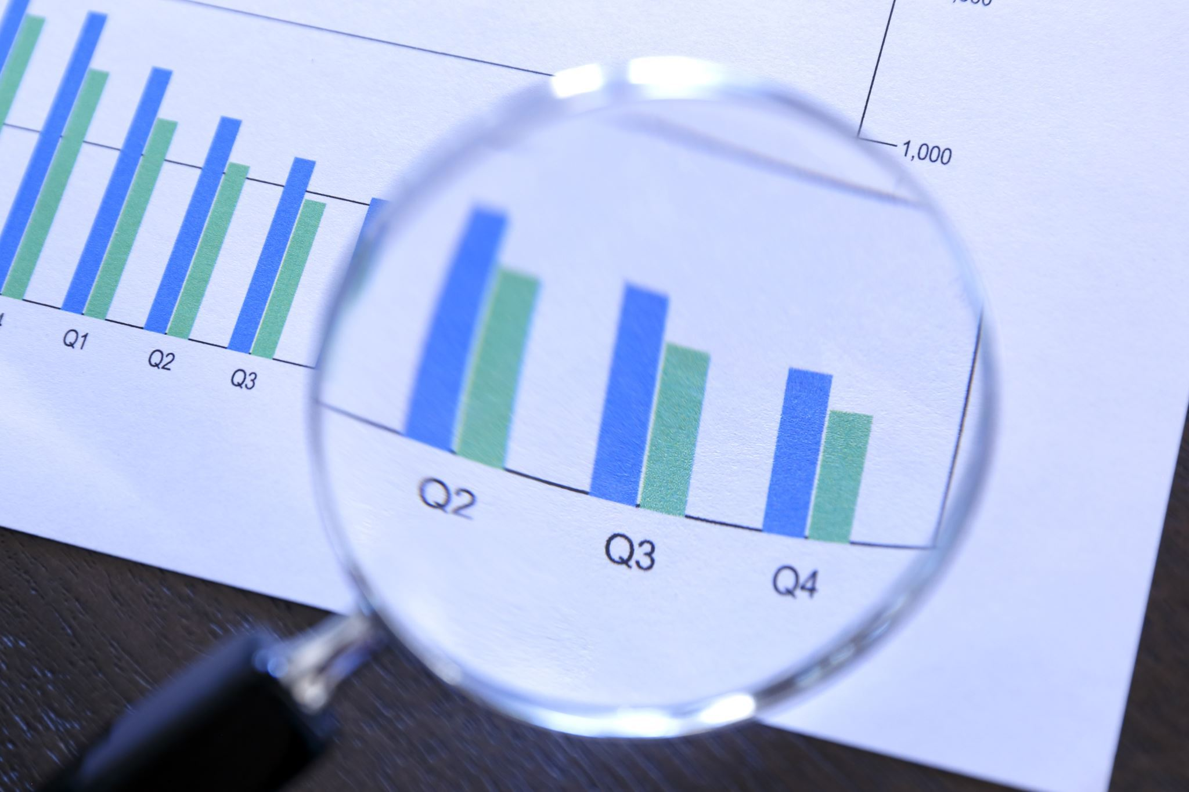
i) Data Cleaning/ Cleansing/ Scrubbing
It is the process of identifying and correcting or removing errors, inconsistencies, and inaccuracies in a dataset to improve its quality and reliability.
Quality issues may be:
Missing values
Duplicate records
Incorrect or inconsistent formatting
Outliers
Irrelevant or redundant data
Inconsistent or inaccurate data etc
Importance:
Make sure data used for modelling is reliable
To give correct insights/ predictions

Slide 27
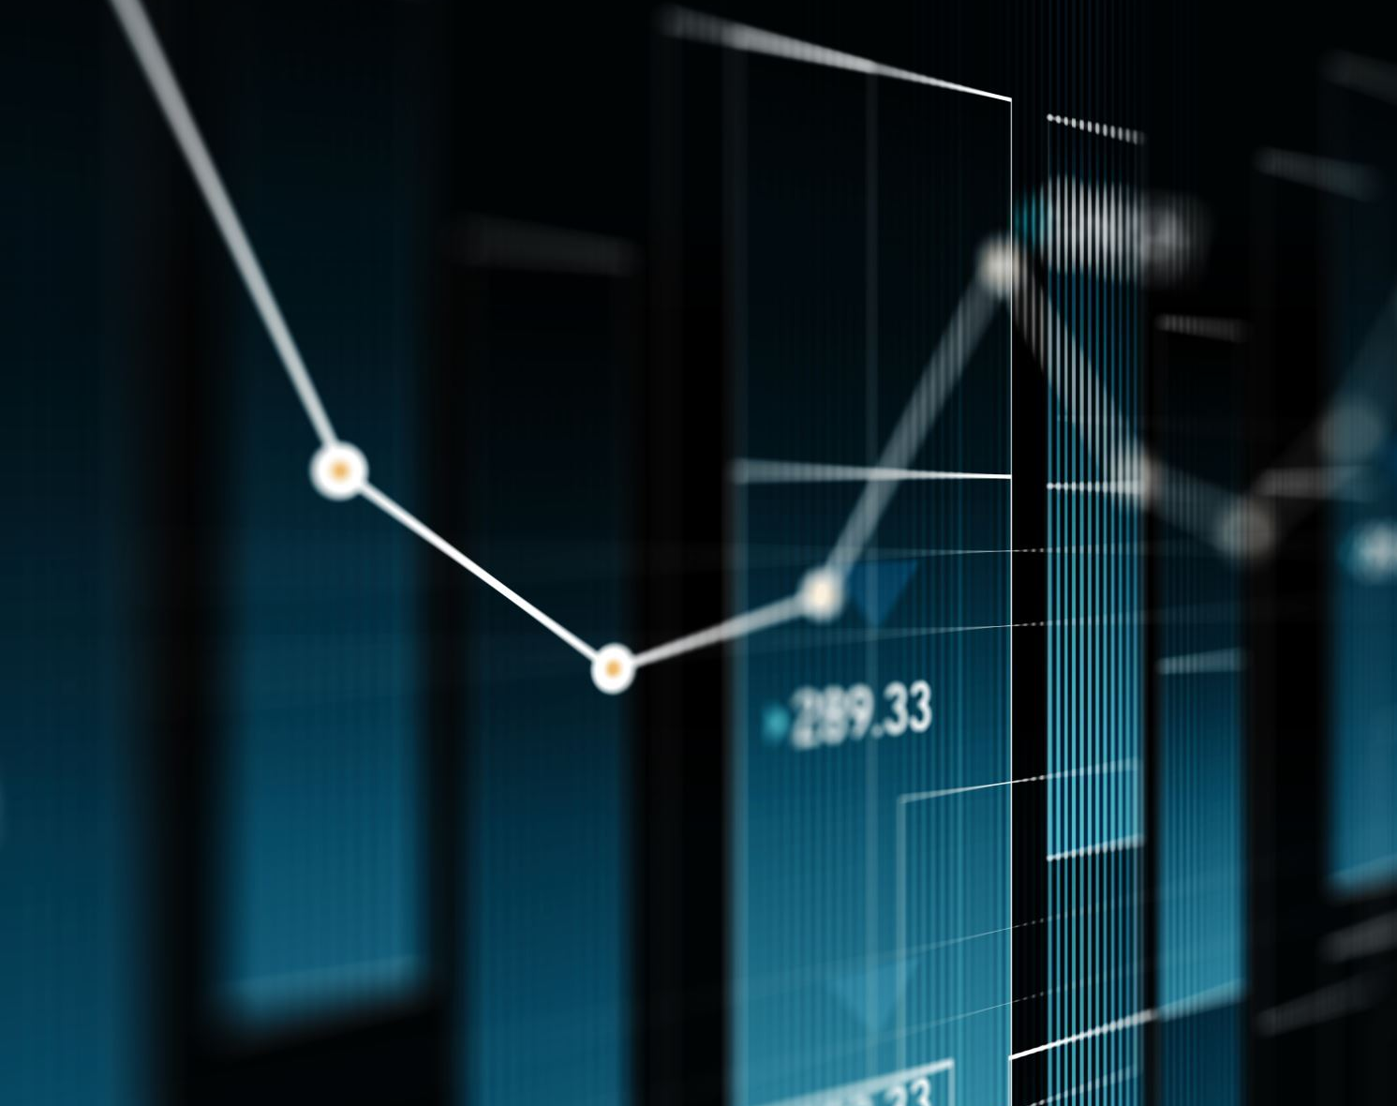
ii) Data Transformation
It is the process of converting or altering data from its original format or representation into a standardized or more suitable format for analysis, modeling, or other data processing tasks.
Why is it done?
Improving data quality
Normalizing data distributions
Reducing skewness for outliers
Scaling variables
Handling non-linear relationships etc
Methods:
Normalization
Standardization
Mathematical transformations (Eg: log)
Handling non-linear relations Eg: polynomial transformations
Binning /dicretization
Encoding categorical variables

Slide 28
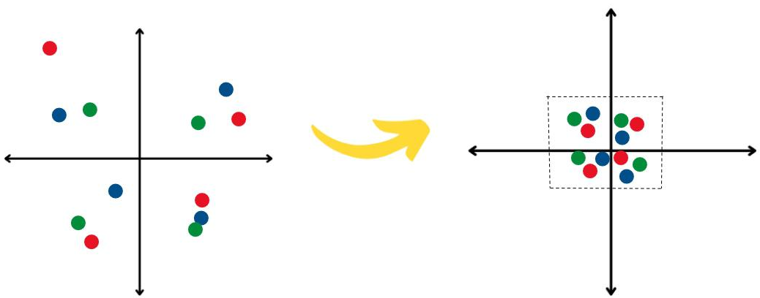
iii) Feature scaling/ Normalization
It is the process of transforming numerical features in a dataset to a similar scale or range.
Why is it done?
To ensure that different features contribute
equally to the analysis or modeling process.
To overcome issues caused by variables with different scales or units.
To facilitates proper comparison, interpretation, and weighting of features in various data processing tasks, such as distance-based algorithms, regression, and clustering.
Methods:
Handling Different Measurement Units
Normalization
Standardization
min-max scaling
Z-score scaling
Log transformation etc

Slide 29
Feature Selection
It is the process of identifying and selecting a subset of relevant features from a larger set of available features in a dataset.
Purpose:
Improve model performance
Reduce overfitting
Enhance interpretability
Reduce computational complexity and
Eliminate irrelevant or redundant features
Methods:
Univariate (looks at each feature independently of others)
Pearson correlation coefficient
F-score
Chi-square
Signal to noise ratio
Multivariate (considers all features simultaneously)
Dimensionality reduction algorithms
Linear classifiers such as support vector machine
Recursive feature elimination

Slide 30
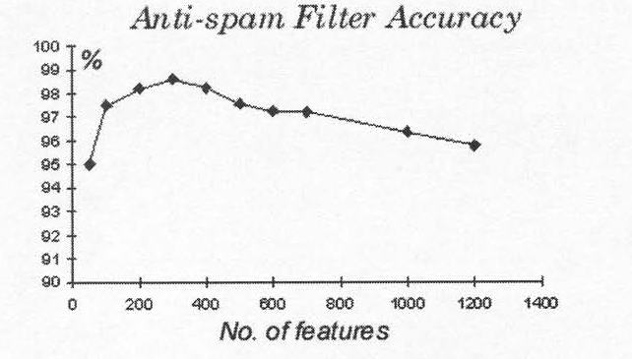
Feature selection: why?

Slide 31

Feature Engineering
It is the process of creating new features or transforming existing features in a dataset to improve the performance of machine learning models.

Slide 32
Model Training
It is the process of teaching a machine learning model to learn patterns and relationships in data to make accurate predictions or decisions.
During training, the model adjusts its internal parameters based on the provided training data and the desired outcomes (labels) to improve its performance.
Key terminologies:
Forward propagation and backpropagation
Loss function
Epochs and batch size
Gradient
Parameter and hyperparameter
Overfitting and underfitting
Evaluation metrics etc
As a continuous process.

Slide 33
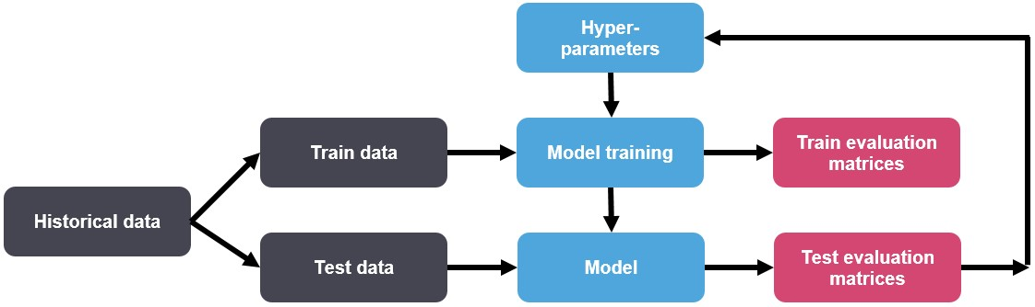
Model training aftermath

Slide 34
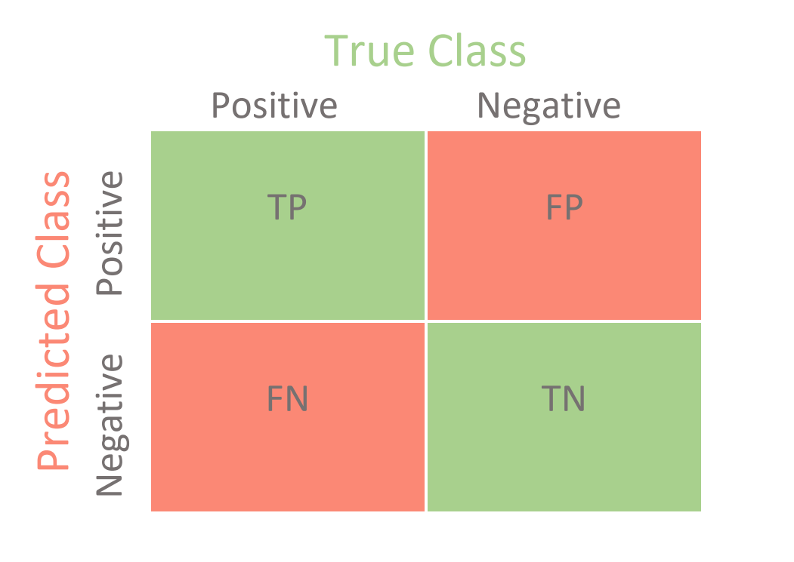
Evaluation Metrics
Confusion matrix
For classification tasks
Metric | Equation
Recall (TPR) | TP/(TP+FN)
FPR | FP/(FP+TN)
Specificity | 1- FPR
Precision | TP/(TP+FP)
Accuracy | (TP+TN)/(TP+TN+FP+FN)
F1 score | (2*P*R)/(P+R)

Slide 35
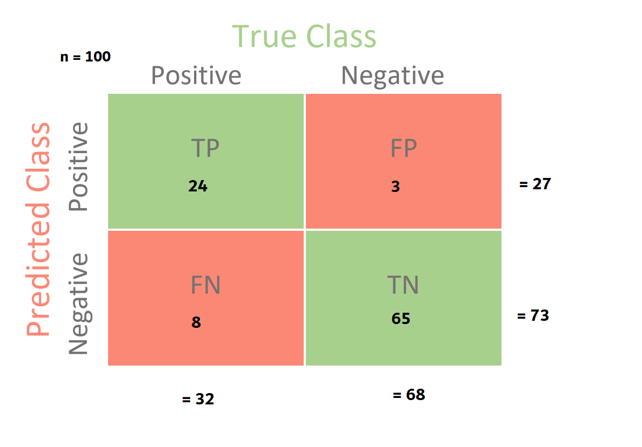
Evaluation Metrics
Confusion matrix
For classification tasks
Metric | Equation | % Value
Recall (TPR) | TP/(TP+FN) | 75
FPR | FP/(FP+TN) | 4.411765
Specificity | 1- FPR | 95.58824
Precision | TP/(TP+FP) | 88.88889
Accuracy | (TP+TN)/(TP+TN+FP+FN) | 89
F1 score | (2*P*R)/(P+R) | 81.35593

Slide 36
Evaluation Metrics
Quantitative measures used to assess the performance of machine learning models.
How well the model is making predictions or decisions on unseen data.
Classification metrics
Accuracy
Precision
Recall (sensitivity/TPR)
F1 score
specificity/ TNR
ROC-AUC curve
Regression metrics
MSE
RMSE
MAE
R-Square / Coeff. Of determination
Clustering metrics
Adjusted rand index
Silhouette score
Other metrics in
Image processing
NLP

Slide 37
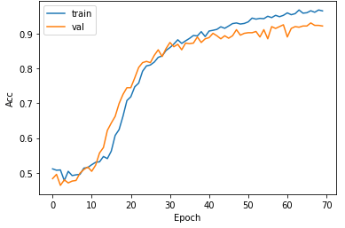
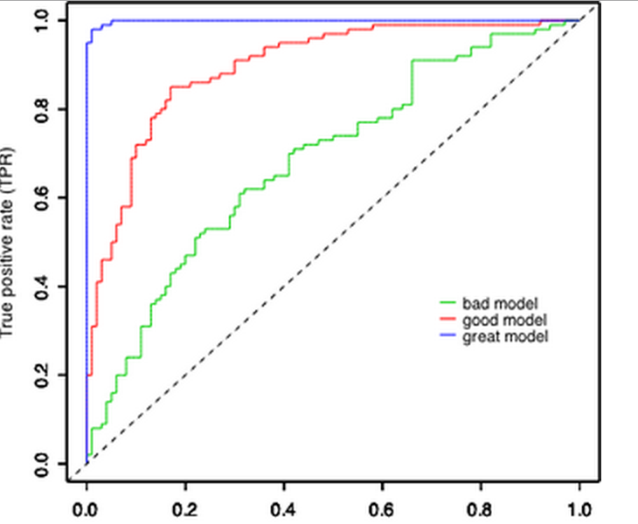
Evaluation Metrics: Example

Slide 38

Let’s get the hands dirty!!

Slide 39
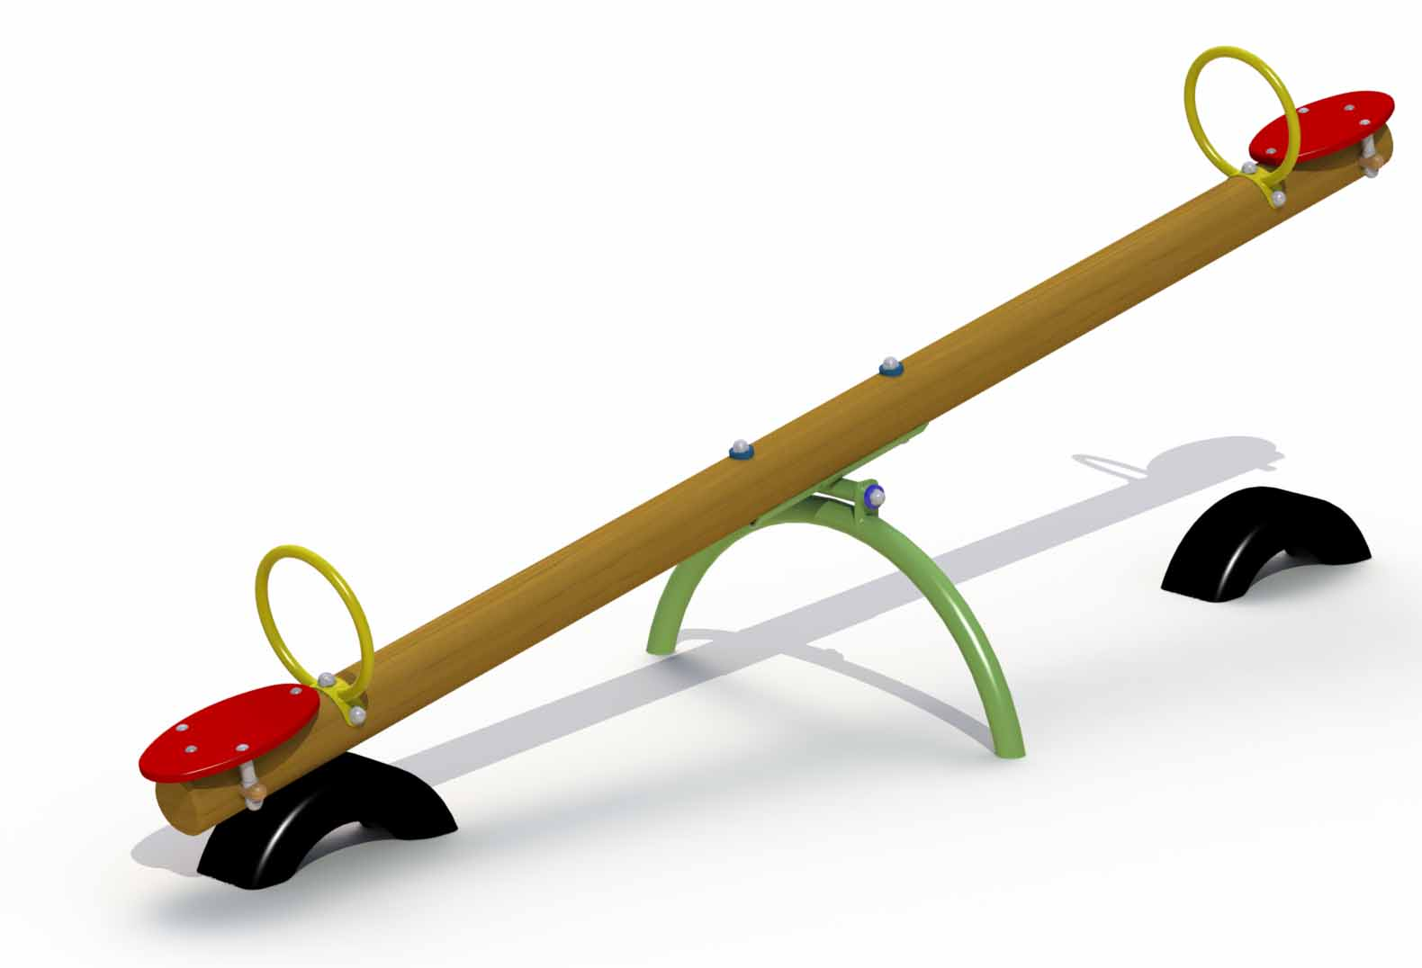
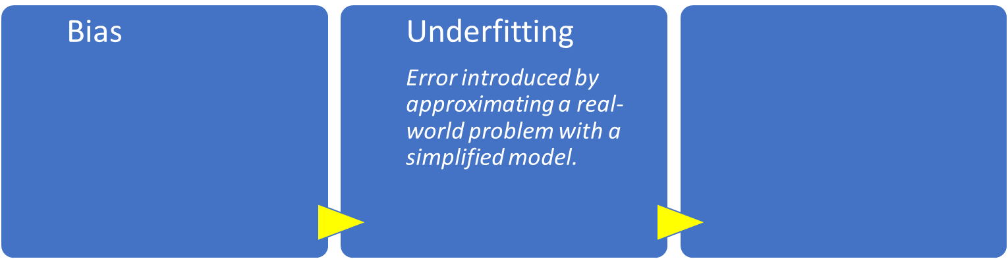

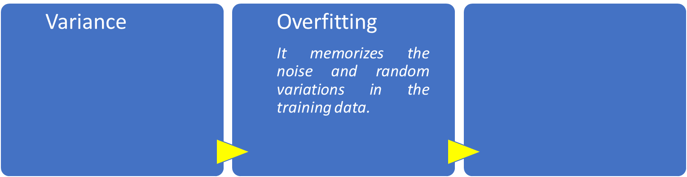

Bias and Variance
Fails to capture the underlying patterns and relationships, resulting in poor performance on both the training and test data.

Slide 40
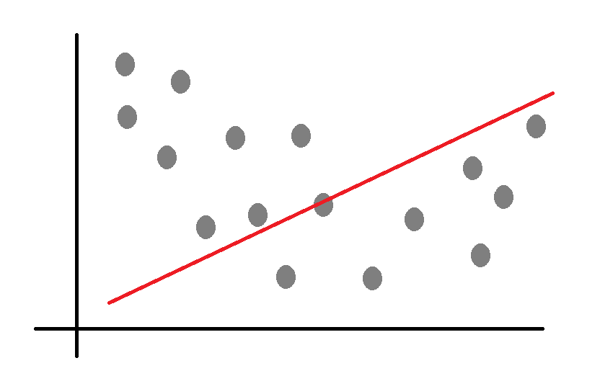
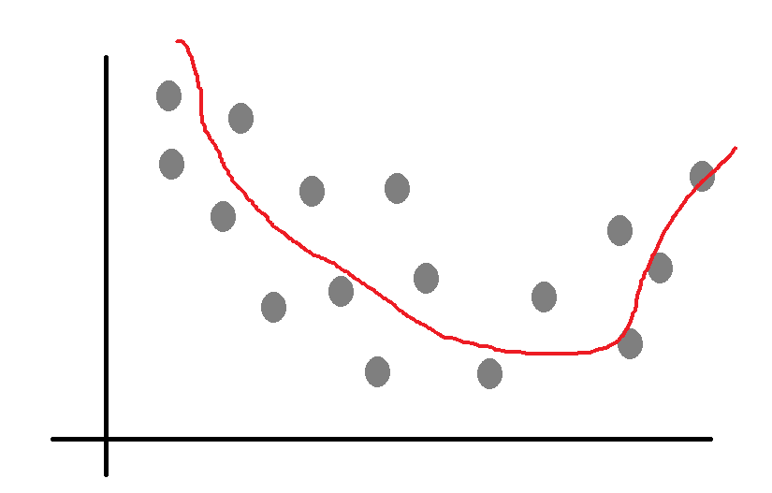
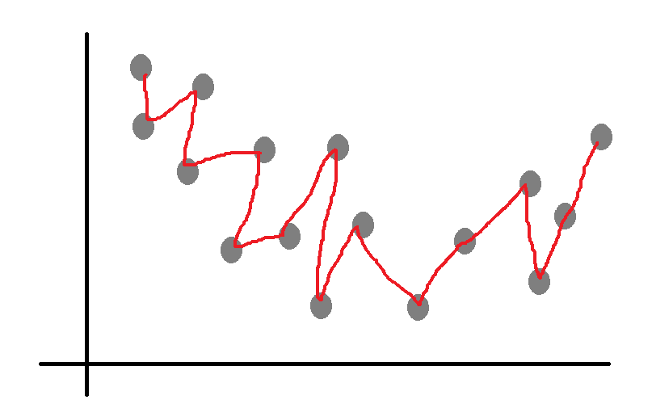
Bias – Variance trade-off
Good model lies here
Underfit
High bias, low variance
High variance, low bias
Good
Error rate
Overfit
Model complexity

Slide 41
Cross Validation
A resampling technique used to evaluate machine learning models by dividing the dataset into multiple subsets, training the model on a portion of the data, and evaluating its performance on the remaining unseen data.
This process is repeated several times to obtain a more robust estimate of the model's performance, especially when the dataset is limited or prone to overfitting.

Slide 42
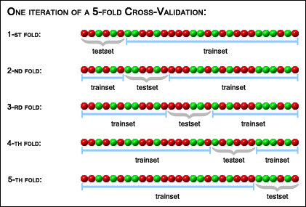
Cross Validation
K-fold cross validation

Slide 43
Model Deployment
Process of taking a trained model and integrating it into a production environment where it can make predictions on new, real-world data.
Why?

Slide 44
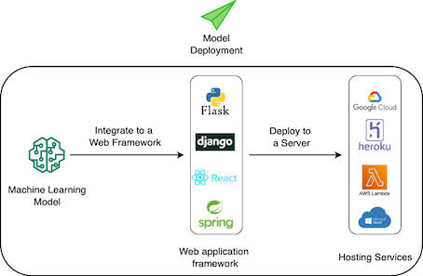
Model Deployment – An example

Slide 45

That’s it!!
You have thus deployed a ML model !!

Slide 46
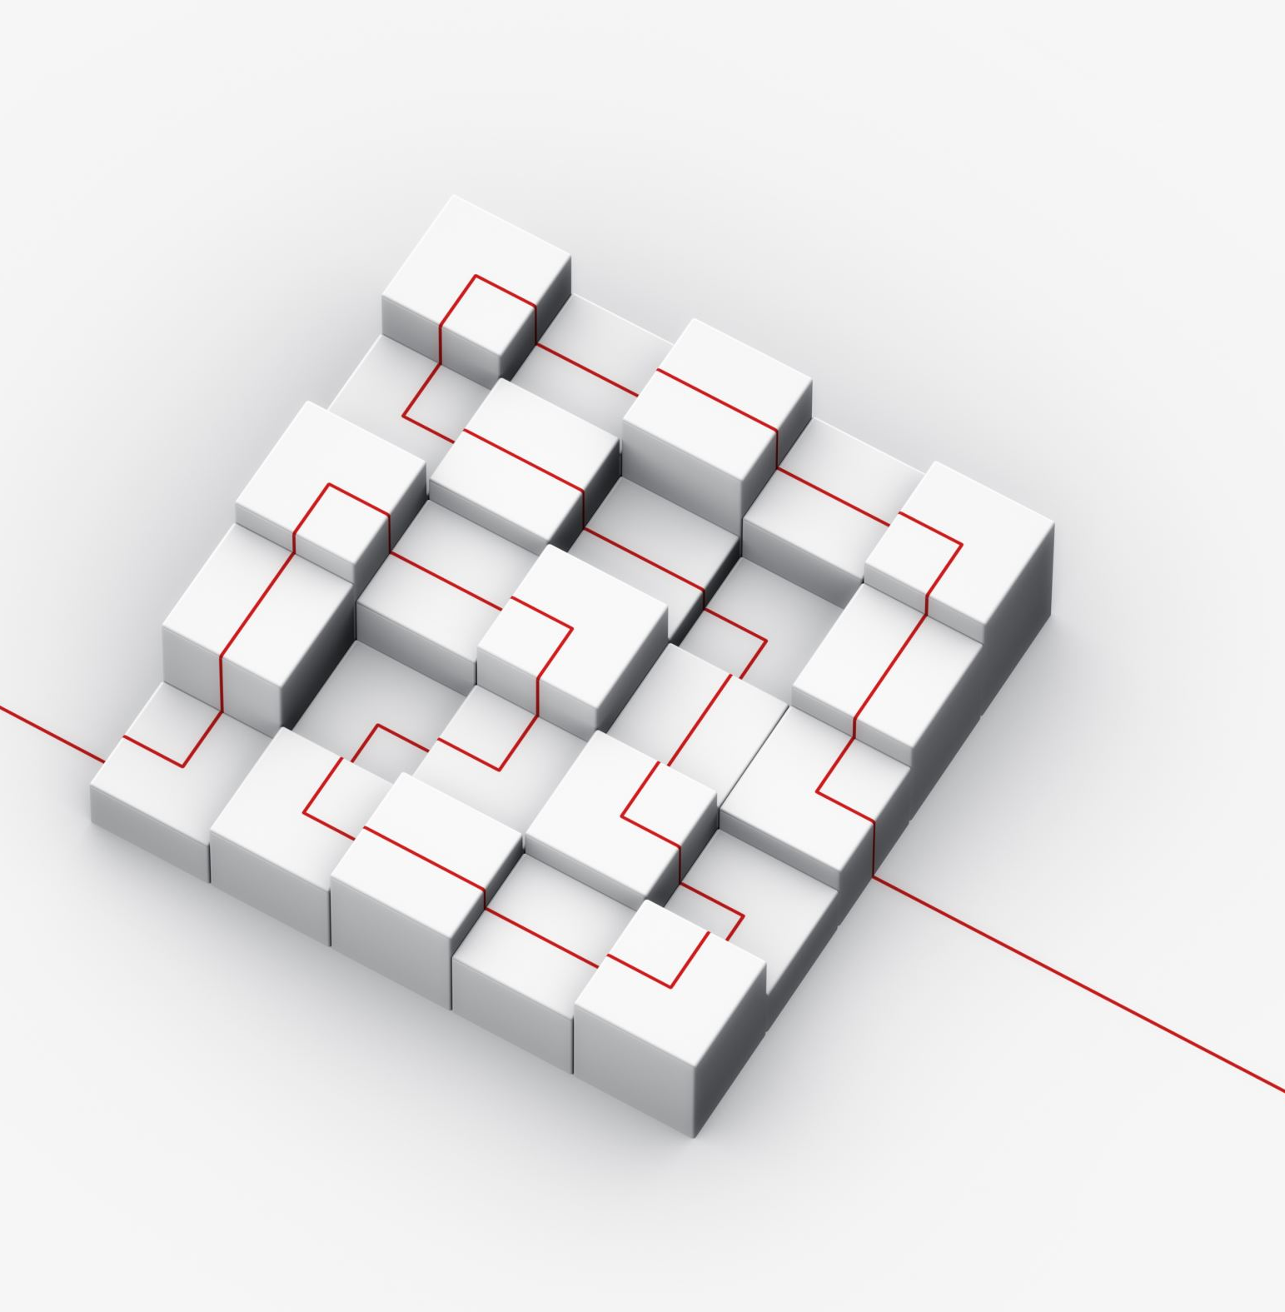
Transfer Learning
Large model trained on one task or dataset is reused as a starting point for another smaller related task or dataset.
Such models are called pre-trained models.
Why?
Pretrained models have better feature representations.
They capture underlying general patterns a cut above.
Hence it makes the training process on smaller dataset more efficient and often leading to better performance.

Slide 47
Transfer Learning
In each of these examples, the pretrained models act as feature extractors, learning meaningful representations from the original tasks' data, which can then be transferred and utilized for better performance on new, related tasks.
Area | Pretrained weight | Transfer learning
Image classification | VGG16, ResNet, or Inception | Cats and dogs classification
Natural Language Processing | Word2Vec, GloVe, or BERT | General NLP applications
Object Detection | MRCNN, Faster R-CNN or YOLO | Vehicle detection, human beings/ animal detection
Speech Recognition | DeepSpeech or Wav2Vec

Slide 48
ML Applications in daily life
Device/ Service | ML Application | Service platform
Virtual Assistants | to understand and respond to voice commands, providing us with information and controlling smart home devices. | Amazon Echo (Alexa), Google Home, and Apple HomePod
Recommendation Systems | suggest personalized content, such as movies, videos, and music, based on our preferences and viewing history. | Netflix, YouTube, and Spotify
Social Media | curate our newsfeeds, showing us posts, ads, and content relevant to our interests and interactions. | Facebook and Instagram
Autocomplete and Text Prediction | Messaging apps, Office assistants, emails | Many large and small service providers
Fraud Detection | detect and prevent fraudulent transactions, protecting users from unauthorized access | Banks and credit card companies
Language Translation | real-time translations between different languages | Google Translate
Healthcare and Diagnostics | to aid in the diagnosis of diseases and medical conditions MRI, CT scans, RVG. | Several companies and hospital chains.
Email Spam Filtering | filter out spam emails and prioritize important messages in our email inboxes | Gmail, Outlook
Personalized Marketing | personalize product recommendations and marketing campaigns based on user behavior and preferences. | E-commerce platforms
Smart Home Devices | smart thermostats and smart lighting and electrical systems | Several companies

Slide 49
ML Applications in the industry
Application | ML rationale
Predictive Maintenance | to predict equipment failures and schedule maintenance activities
Supply Chain Optimization | optimize supply chain management by predicting demand, optimizing inventory levels, and streamlining logistics.
Quality Control | automotive and electronics - inspect and detect defects in products during manufacturing processes.
Customer Service Chatbots
Financial Analysis | credit risk assessment, fraud detection, and stock market prediction.
Traffic Management | to optimize traffic flow, reduce congestion, and manage transportation systems efficiently.
Energy Management | to optimize energy consumption and grid management in the energy sector.
Agriculture | Precision agriculture - to optimize crop yield, monitor soil health, and manage resources efficiently.
Human Resources | in HR departments for candidate screening, employee performance analysis, and talent retention strategies.
Marketing and Advertising | target the right audience, personalize advertising campaigns, and measure the effectiveness of marketing efforts.

Slide 50
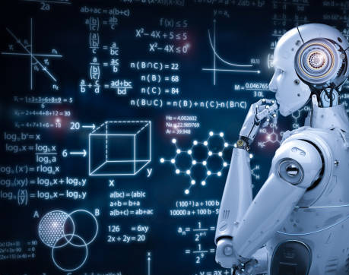
Introduction to Neural Networks & Deep Learning

Slide 51
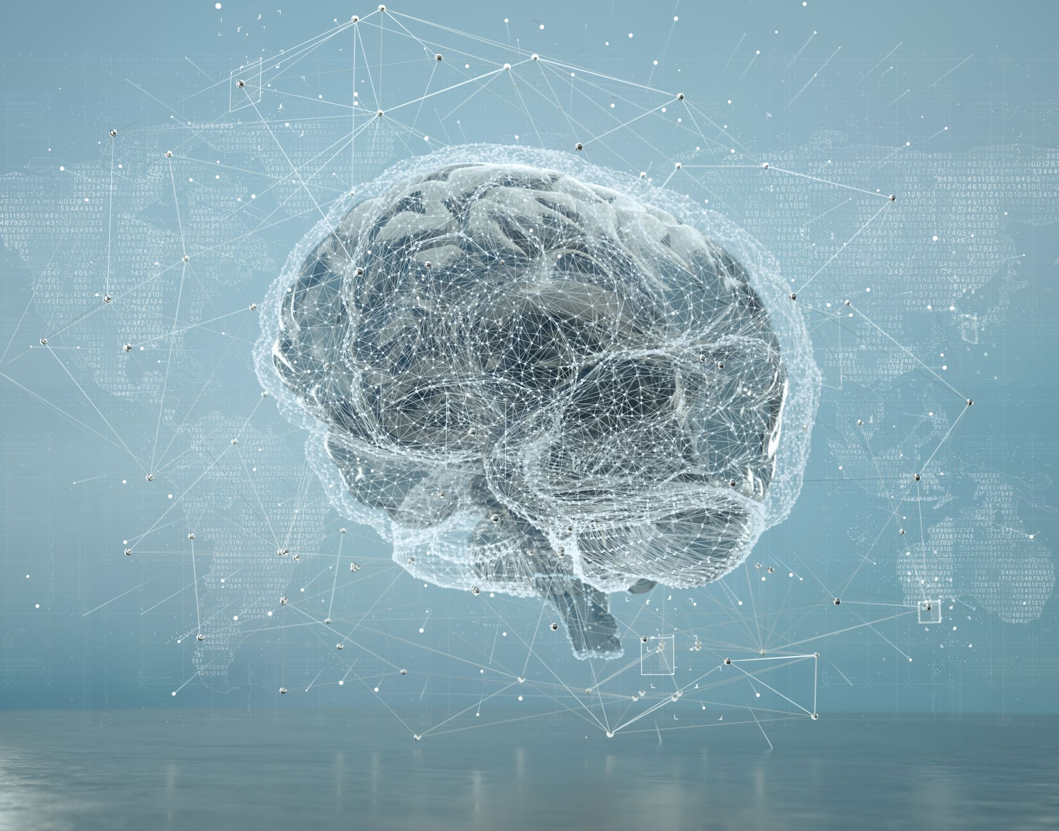
Overview
Relation to Biological Brain: Biological Neural Network
The Artificial Neuron
Types of Networks and Learning Techniques
Supervised Learning & Backpropagation Training Algorithm

Slide 52
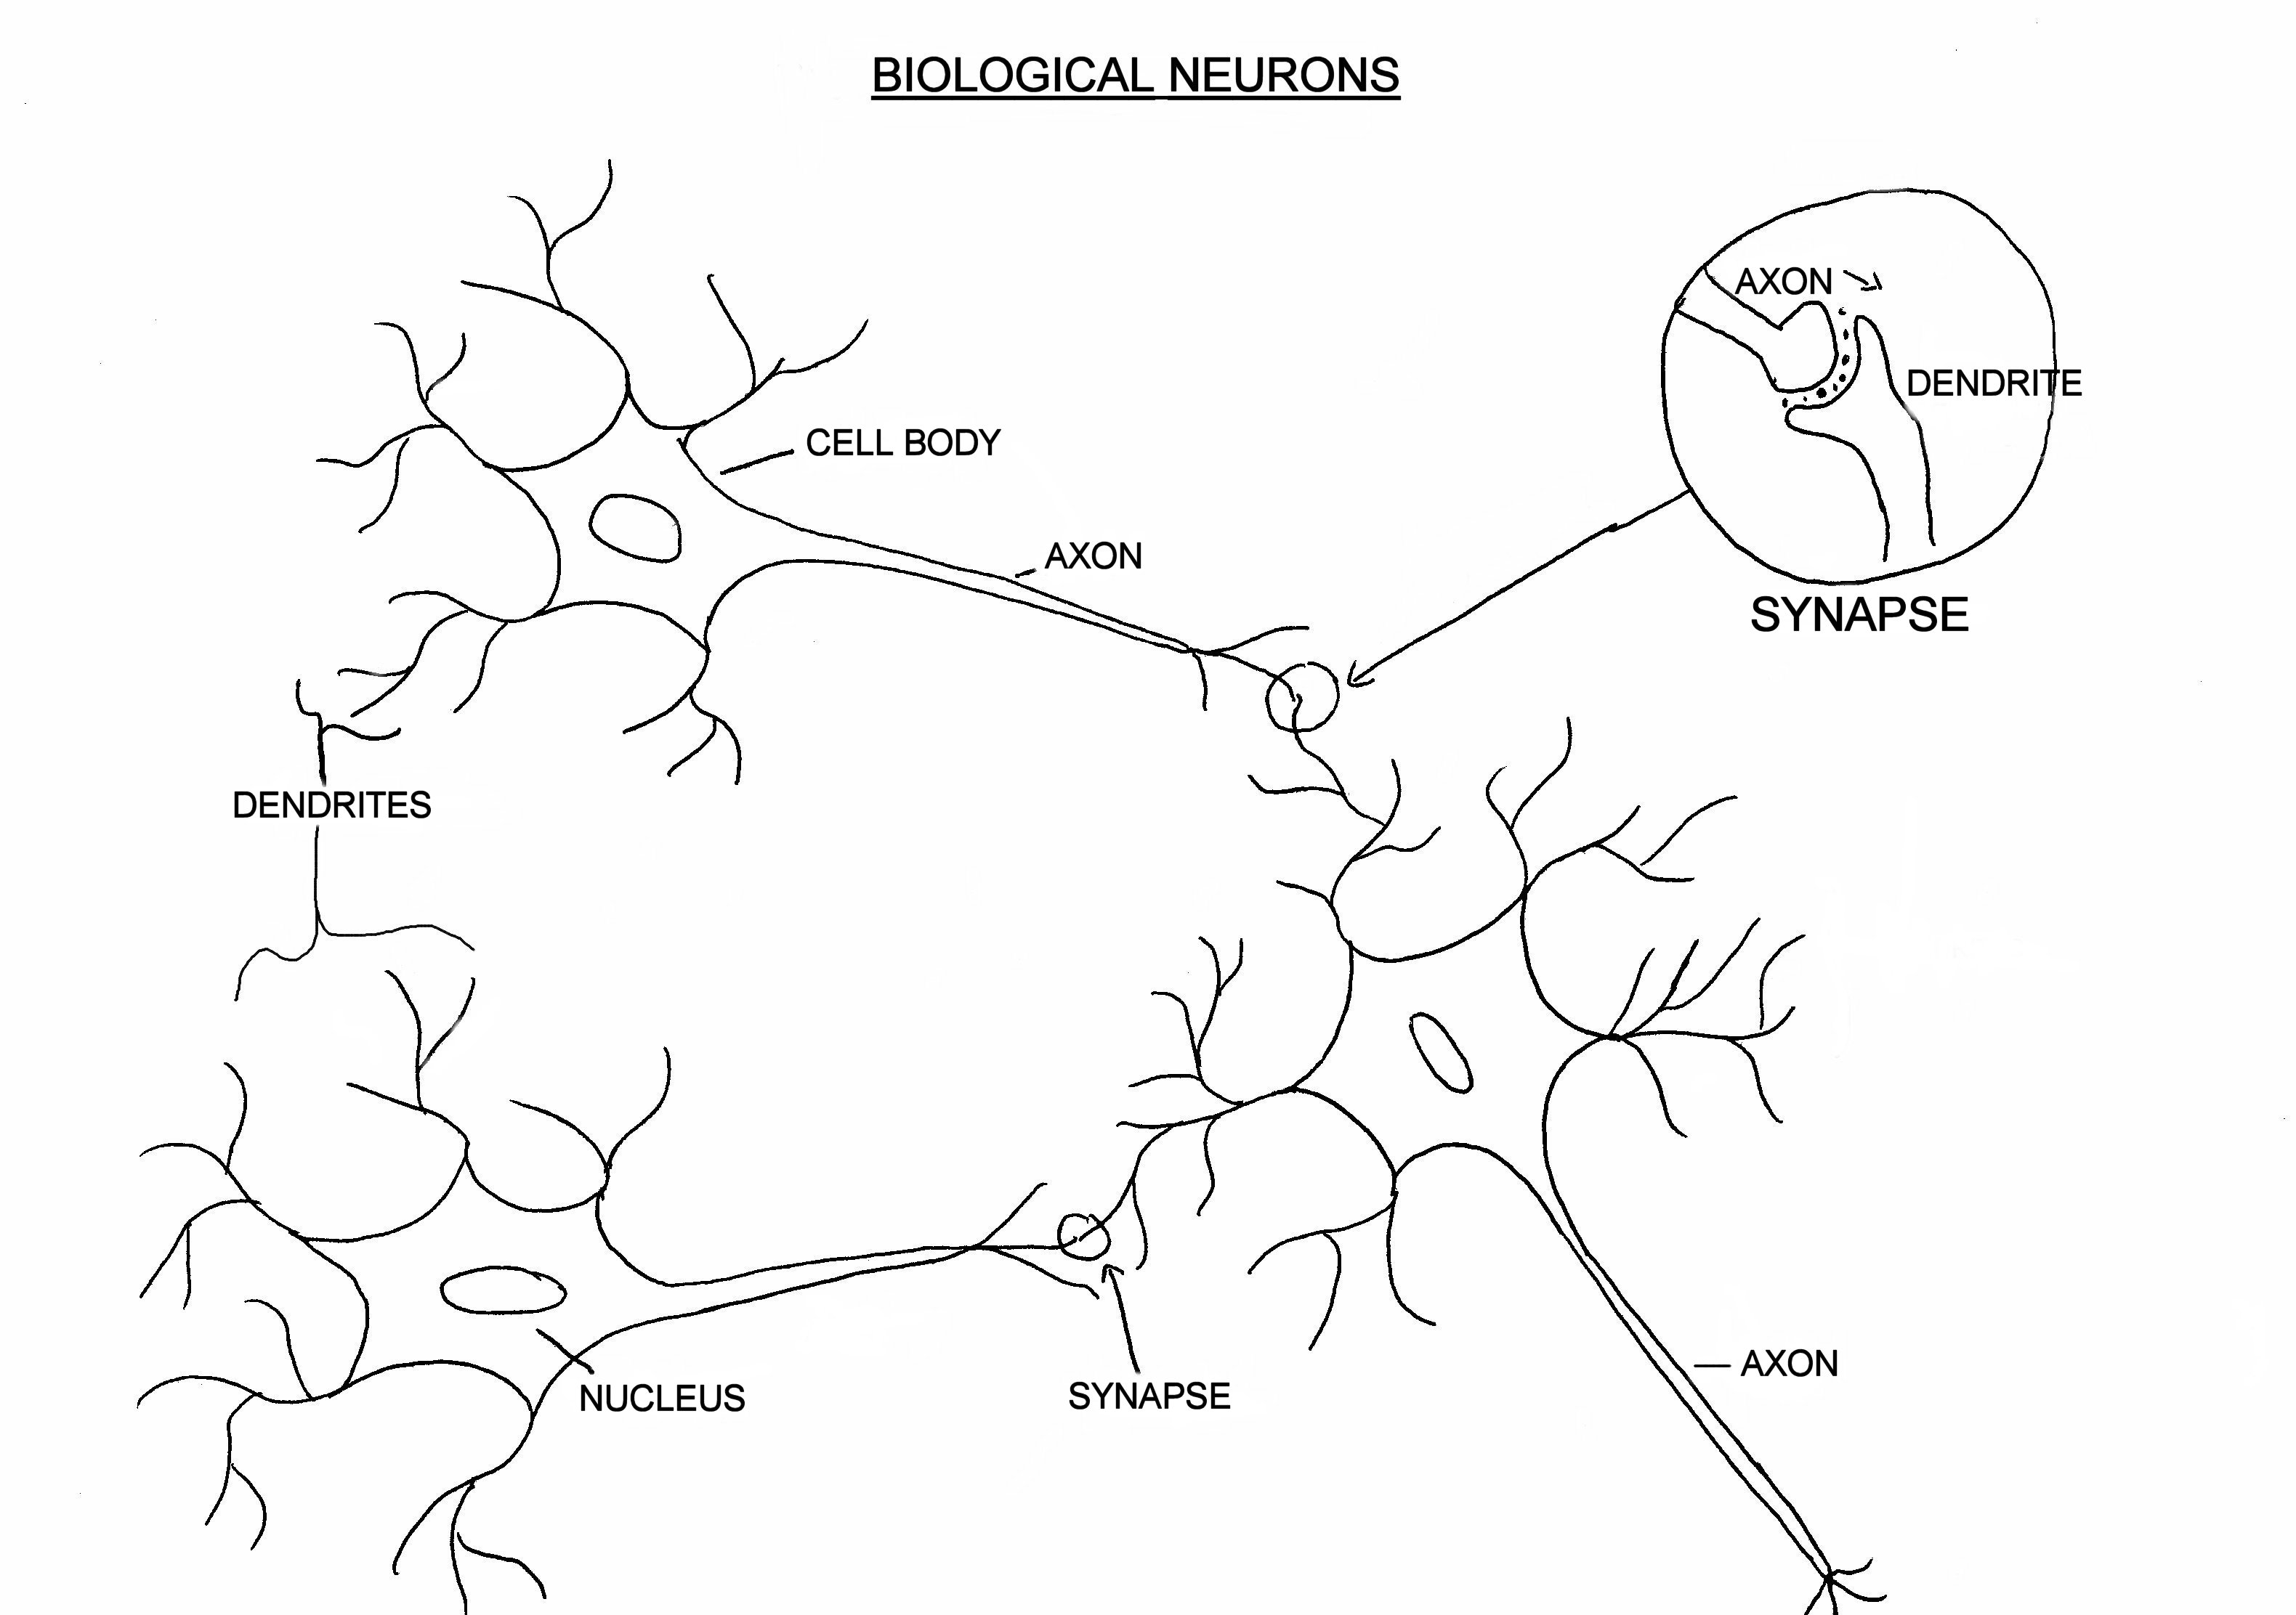
The Inspiration: Biological Neuron
Evolved through million of years.
Animal neuron.

Slide 53
Can we mimic the BNs?
Biologists
Neuroscientists
Mathematicians
Computer scientists and engineers …

Slide 54
Artificial Neuron
W
Neuron
INPUTS
W
Σ
f(n)
Outputs
W
Activation
Function
W
W=Weight

Slide 55
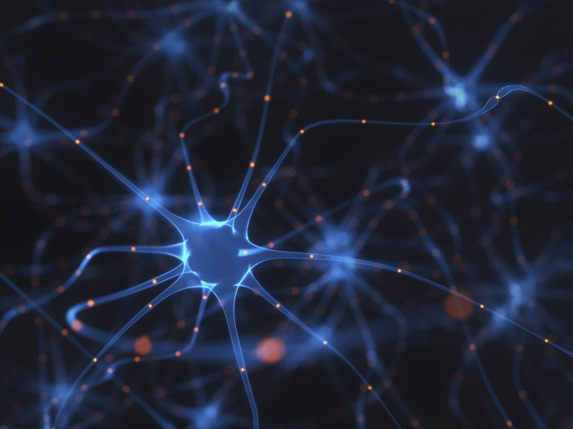
Basic Components of an ANN
Neurons: The fundamental units that process and transmit information within the network.
Weights: Numeric values that modulate the strength of connections between neurons.
Activation Function: Introduces non-linearity, determining if a neuron should be activated or not.
Layers: Organize neurons into distinct groups, such as input, hidden, and output layers.

Slide 56
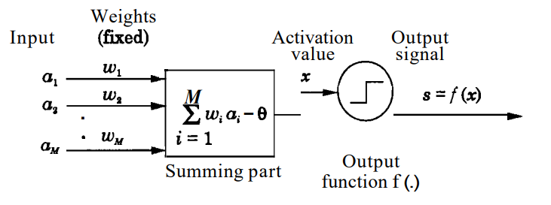
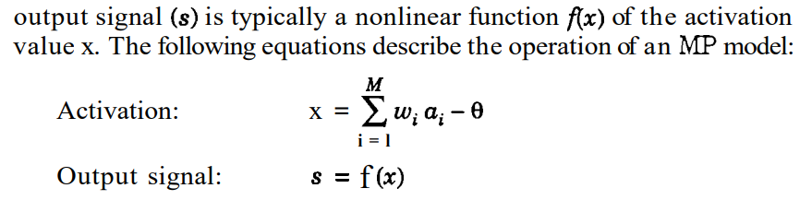
MP (McCullock-Pitts) Neuron- 1943
Nerve cell – simple logic gate – binary output
Multiple signals arrive at dendrite
At cell body – threshold – output is generated
Activation non linear functions – binary, ramp and sigmoid.
All inputs are Boolean, output is also Boolean.

Slide 57
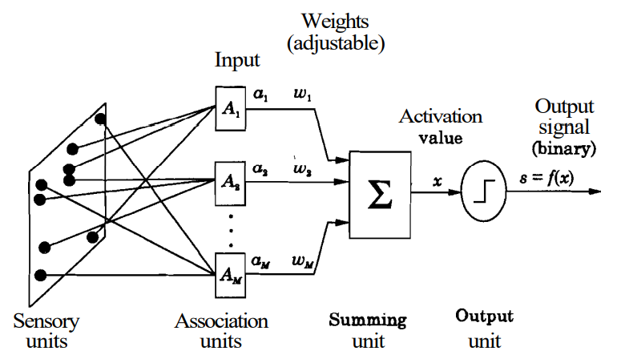
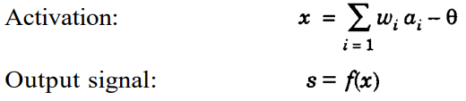
Perceptron (Frank Rosenblatt 1957)
Based on MP model
Basic ANN model
Algorithm for supervised learning for binary classifier
Types: Single layer & Multi layer
Input values, weights, bias & net sum
Weights adjustable by perceptron learning law.
If the weight values converge, then the corresponding problem is said to be represented by the perceptron network.

Slide 58
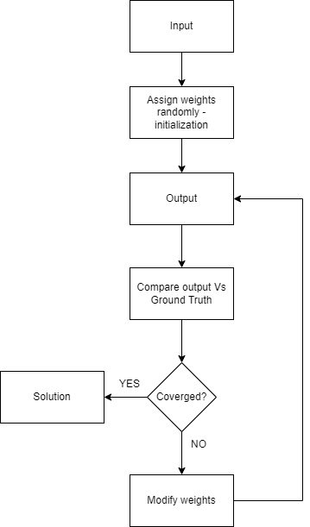
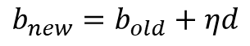
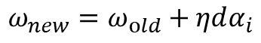
Single Layer Perceptron : Working algorithm
Major aim – Linearly separate objects with binary outcomes.
Can only learn linearly separate patterns.
Linear regression
Weight updating rule
$$ω_{new}=ω_{old}+ηdα_{i}$$
$$b_{new}=b_{old}+ηd$$
Notes:
1) Feedforward with numbers – example, 2) Write patterns and explain.

Slide 59
Topologies of Neural Networks
Feedback
Multiple Inputs and Single Layer
Multiple Inputs and layers
Recurrent Networks

Slide 60
Multilayer Perceptron
Output Layer
Inputs
First Hidden layer
Second Hidden Layer

Slide 61
Signal Flow Backpropagation of Errors
Function Signals
Error Signals

Slide 62
Artificial Neural Networks (ANNs) are trained through a series of steps to make accurate predictions on given data.
Training Data:
ANNs require a dataset containing input-output pairs for training.
Example: Images with corresponding labels for image recognition.
Forward Pass:
Data flows from input to output through the network during training.
Each layer processes the input and passes it to the next layer.
Hidden layers learn representations, and the output layer produces predictions.
Loss Function:
Measures the difference between predicted and actual outputs.
Quantifies how "wrong" the predictions are for given inputs.
Backpropagation:
Algorithm to adjust weights and reduce the loss.
Calculates the gradient of the loss function with respect to each weight.
Updates weights in the opposite direction of the gradient.
Repetition of backpropagation allows the network to learn from the data.
Optimization:
Utilizes algorithms like Gradient Descent, Adam, etc.
Efficiently updates weights during backpropagation.

Slide 63


Slide 64
Important Components for Training a Neural Network

Slide 65
What is a Loss Function?
A loss function, also known as a cost function or objective function, measures the difference between predicted and actual values during training.
It quantifies the model's performance and guides the optimization process by providing feedback on the model's error.
The choice of loss function depends on the task type, such as regression, classification, or other specialized tasks.
Importance of Loss Functions
Loss functions play a crucial role in training a neural network effectively.
By computing the error between predictions and actual targets, loss functions guide the optimizer to update model parameters in the right direction.
Selecting an appropriate loss function is essential for achieving good generalization and accurate predictions on unseen data.
Loss Function

Slide 66
Types of Loss Functions
Mean Squared Error (MSE):
Commonly used for regression tasks.
It measures the average squared difference between predicted and actual values, penalizing larger errors more heavily.
MSE is sensitive to outliers and is suitable when the target values are continuous.
Cross-Entropy Loss:
Widely used for classification tasks.
It measures the dissimilarity between predicted probabilities and actual one-hot encoded labels.
Cross-entropy loss encourages the model to assign high probabilities to the correct class.
Binary Cross-Entropy:
Used for binary classification problems.
Suitable when there are only two classes.
The model's output is typically passed through a sigmoid activation function to represent the probability of the positive class.
Categorical Cross-Entropy:
Applicable for multi-class classification tasks.
Handles scenarios with more than two classes.
The model's output is usually passed through a softmax activation function to interpret the results as class probabilities.

Slide 67
Optimizers
What are Optimizers?
Optimizers are algorithms used to optimize the weights and biases of neural networks during the training process.
Their primary goal is to minimize the loss function and improve the model's performance.
Neural networks are trained through an iterative process where the optimizer adjusts the model's parameters based on the gradients of the loss function.
Importance of Optimizers
Neural networks often have millions of parameters, making manual optimization impractical.
Optimizers automate the process of adjusting weights and biases to find the optimal values that reduce the error between predictions and actual targets.
Without optimizers, training neural networks would be computationally infeasible, especially for complex architectures like deep convolutional neural networks and recurrent neural networks.

Slide 68
Popular Optimizers
Gradient Descent:
The basic optimization algorithm used in neural networks.
It calculates the gradients of the loss function with respect to each parameter and updates them by taking steps proportional to the negative of the gradient.
Gradient descent can be slow and may converge to local minima, but it serves as the foundation for more advanced optimizers.
Stochastic Gradient Descent (SGD):
A variant of gradient descent that randomly selects a mini-batch of samples for each update step.
This randomness introduces noise into the parameter updates, which can help escape local minima and converge faster.
SGD is computationally efficient and widely used in large-scale deep learning tasks.
Adam (Adaptive Moment Estimation):
An adaptive learning rate optimization algorithm.
Adam combines the advantages of RMSprop and momentum methods.
It adapts the learning rates of each parameter based on the historical gradients, making it well-suited for tasks with sparse gradients or varying magnitudes.

Slide 69


Slide 70
So what is Deep Learning?
Deep learning refers to the use of multi-layered artificial neural networks to solve complex problems. These neural networks are called "deep" because they consist of multiple hidden layers between the input and output layers. The term "deep" signifies the depth of the network, indicating the presence of several hidden layers in the architecture.

Slide 71
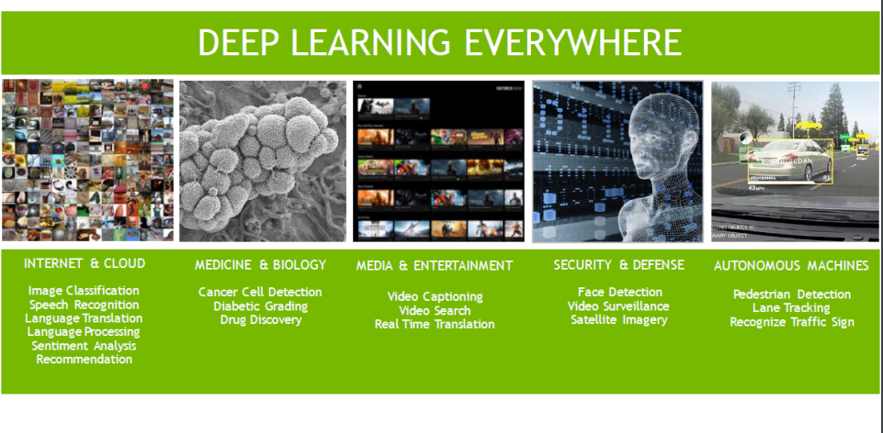

Slide 72
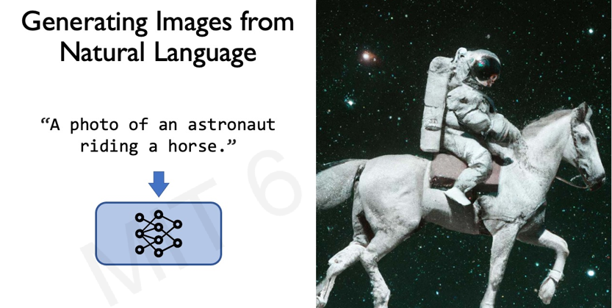

Slide 73



Slide 74
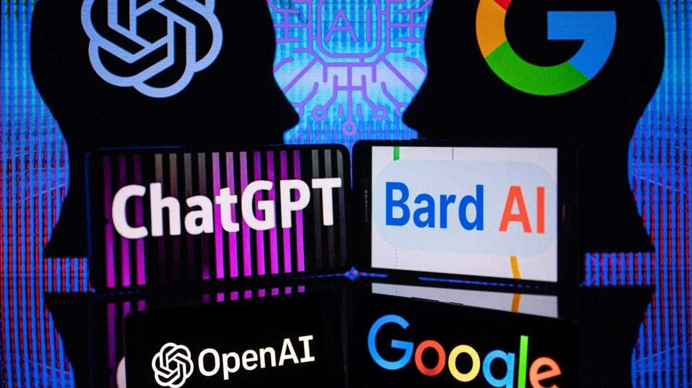

Slide 75
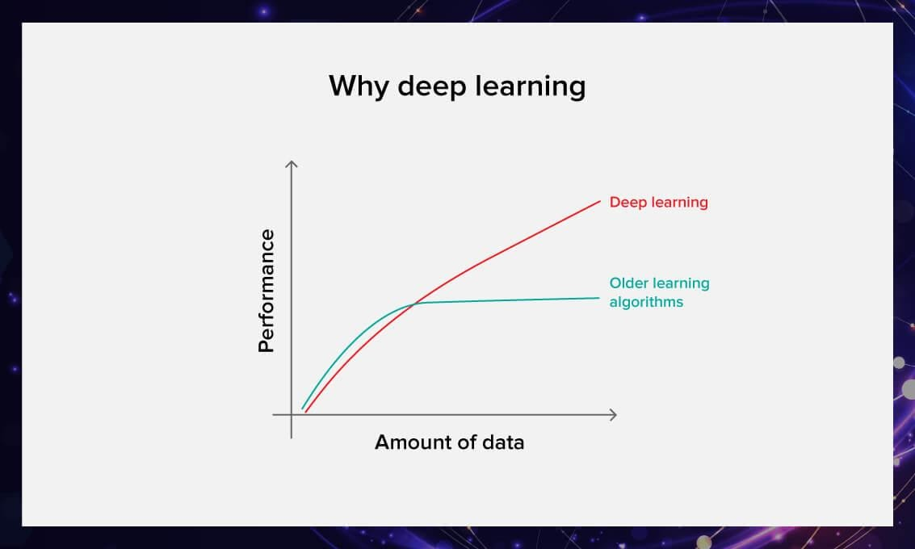

Slide 76
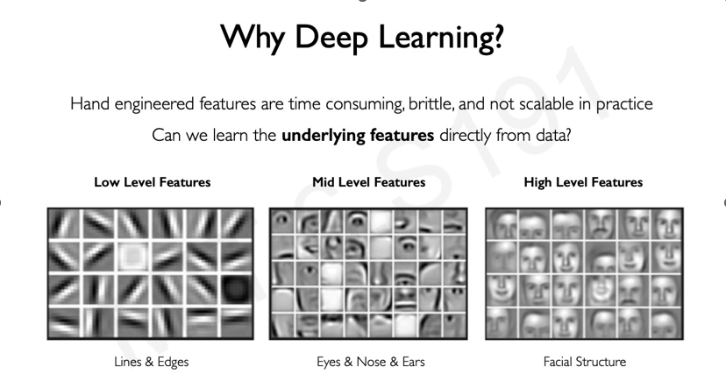

Slide 77
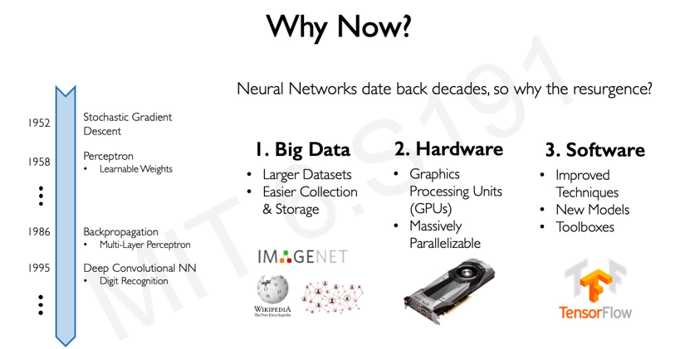

Slide 78

Convolutional Neural Networks
CNN is a deep learning model specialized for image and video processing. Designed to automatically learn spatial hierarchies of features from visual data.
Key Components:
Convolutional Layers: Extract local patterns using convolution operations.
Pooling Layers: Downsample and reduce spatial dimensions while retaining important features.
Fully Connected Layers: Produce final output predictions.
Applications:
Image Classification: Identifying objects in images (e.g., recognizing cats or dogs).
Object Detection: Locating and classifying multiple objects in an image.
Image Segmentation: Assigning semantic labels to each pixel in an image.

Slide 79


Slide 80
RNN is a type of neural network well-suited for sequential data. Process inputs with temporal dependencies, such as time series or natural language.
Key Components:
Recurrent Connections: Loops allow information to persist across time steps.
Hidden States: Store historical information from previous inputs.
Time Unfolding: Illustrate RNN as a series of connected cells over time.
Sequential Data Processing:
Time Series Prediction: Forecasting future values based on past data.
Natural Language Processing: Language modeling, machine translation, and text generation.
Speech Recognition: Converting spoken language into written text.
Limitations:
Short-term Memory: Struggles with capturing long-range dependencies.
Vanishing/Exploding Gradients: Issues during training with deep RNNs.
Long Short-Term Memory (LSTM) and Gated Recurrent Unit (GRU) models as solutions.
Recurrent Neural Networks

Slide 81


Slide 82
GAN is a deep learning framework for generating synthetic data. Learn to produce data similar to a given training dataset.
Key Components
Generator: Produces synthetic data instances from random noise.
Discriminator: Attempts to distinguish between real and fake data.
Adversarial Training: Generator and discriminator play a "cat-and-mouse" game.
GAN Training
Generator Loss: Minimize the discriminator's ability to differentiate fake data.
Discriminator Loss: Maximize the discriminator's ability to differentiate real from fake.
Applications
Image Generation: Creating realistic images of people, animals, and objects.
Style Transfer: Converting images to match artistic styles or filters.
Data Augmentation: Expanding training datasets for other machine learning tasks.
Generative Adversarial Networks

Slide 83


Slide 84
Transformers are a powerful deep learning architecture for sequential data processing. Facilitate parallel computation and capture long-range dependencies.
Key Components
Self-Attention Mechanism: Weighing the importance of different input elements.
Encoder-Decoder Architecture: Used in tasks like machine translation.
Multi-Head Attention: Using multiple attention heads to capture different aspects.
Advantages
Parallel Computation: Allows efficient processing of sequential data.
Long-Range Dependencies: Captures relationships between distant elements.
Transfer Learning: Pre-trained transformer models like BERT and GPT.
Applications
Natural Language Processing: Machine translation, sentiment analysis, text generation.
Language Understanding: Extracting contextual information from text.
Image Generation: Transformer-based models for image synthesis (e.g., DALL-E).
Transformers

Slide 85


Slide 86


Slide 87

Questions

Slide 88

A tiny note
These slides were created with the help of AI !
This Photo by Unknown author is licensed under CC BY-SA-NC.

